Slide 1

Electiva - Reconocimiento de Patrones
Ingeniería de Software

Slide 2
Descriptores de textura

Slide 3
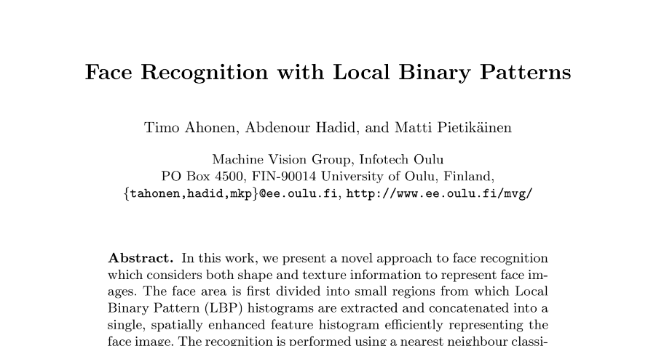

Slide 4
Local Binary Patterns
Coding
Mapping
Histogram
1
2
3
IMAGE
FEATURE
Cortesía: Profesor Domingo Mery

Slide 5
Local Binary Patterns
Coding
Mapping
Histogram
1
2
3
IMAGE
FEATURE

Slide 7
4
6
9
6
4
6
9
6
4
9
9
9
9
6
2
2
9
2
10
10
10
10
10
10

Slide 8
4
6
9
6
4
6
9
6
4
9
9
9
9
6
2
2
9
2
10
10
10
10
10
10

Slide 9
4
6
9
4
6
9
6
4
6
9
6
4
9
6
4
9
9
9
9
6
2
9
6
2
2
9
2
10
10
10
10
10
10

Slide 10
4
6
9
6
4
6
9
6
4
9
9
9
9
6
2
2
9
2
10
10
10
10
10
10
4
6
9
<
9
6
4
9
6
2

Slide 11
4
6
9
6
4
6
9
6
4
9
9
9
9
6
2
2
9
2
10
10
10
10
10
10
4
6
9
0
9
6
4
9
6
2
0: <
1: ≥

Slide 12
4
6
9
6
4
6
9
6
4
9
9
9
9
6
2
2
9
2
10
10
10
10
10
10
4
6
9
0
≥
9
6
4
9
6
2
0: <
1: ≥

Slide 13
4
6
9
6
4
6
9
6
4
9
9
9
9
6
2
2
9
2
10
10
10
10
10
10
4
6
9
0
1
9
6
4
9
6
2
0: <
1: ≥

Slide 14
4
6
9
6
4
6
9
6
4
9
9
9
9
6
2
2
9
2
10
10
10
10
10
10
4
6
9
0
1
1
9
6
4
9
6
2
0: <
1: ≥

Slide 15
4
6
9
6
4
6
9
6
4
9
9
9
9
6
2
2
9
2
10
10
10
10
10
10
4
6
9
0
1
1
9
6
4
0
9
6
2
0: <
1: ≥

Slide 16
4
6
9
6
4
6
9
6
4
9
9
9
9
6
2
2
9
2
10
10
10
10
10
10
4
6
9
0
1
1
9
6
4
0
9
6
2
0
0: <
1: ≥

Slide 17
4
6
9
6
4
6
9
6
4
9
9
9
9
6
2
2
9
2
10
10
10
10
10
10
4
6
9
0
1
1
9
6
4
0
9
6
2
1
0
0: <
1: ≥

Slide 18
4
6
9
6
4
6
9
6
4
9
9
9
9
6
2
2
9
2
10
10
10
10
10
10
4
6
9
0
1
1
9
6
4
0
9
6
2
1
1
0
0: <
1: ≥

Slide 19
4
6
9
6
4
6
9
6
4
9
9
9
9
6
2
2
9
2
10
10
10
10
10
10
4
6
9
0
1
1
9
6
4
1
0
9
6
2
1
1
0
0: <
1: ≥

Slide 20
4
6
9
6
4
6
9
6
4
9
9
9
9
6
2
2
9
2
10
10
10
10
10
10
4
6
9
0
1
1
1
2
4
9
6
4
1
0
x 128 +
8
= 2+4+32+64+128 = 230
9
6
2
1
1
0
64
32
16
0: <
1: ≥

Slide 21
4
6
9
6
4
6
9
6
4
9
9
9
9
6
2
2
9
2
10
10
10
10
10
10
4
6
9
0
1
1
1
2
4
9
6
4
1
0
x 128 +
8
= 2+4+32+64+128 = 230
9
6
2
1
1
0
64
32
16
0: <
1: ≥

Slide 22
4
6
9
6
4
6
9
6
4
9
9
9
230
9
6
2
2
9
2
10
10
10
10
10
10
4
6
9
0
1
1
1
2
4
9
6
4
1
0
x 128 +
8
= 2+4+32+64+128 = 230
9
6
2
1
1
0
64
32
16
0: <
1: ≥

Slide 23
4
6
9
6
4
6
9
6
4
9
9
9
230
?
9
6
2
2
9
2
10
10
10
10
10
10
6
9
6
1
2
4
6
4
9
x 128 +
8
6
2
2
64
32
16
0: <
1: ≥

Slide 24
4
6
9
6
4
6
9
6
4
9
9
9
230
207
9
6
2
2
9
2
10
10
10
10
10
10
6
9
6
1
1
1
1
2
4
6
4
9
1
1
x 128 +
8
= 1+2+4+8+64+128 = 207
6
2
2
1
0
0
64
32
16
0: <
1: ≥

Slide 25
4
6
9
6
4
6
9
6
4
9
9
9
230
207
?
9
6
2
2
9
2
10
10
10
10
10
10

Slide 26
4
6
9
6
4
6
9
6
4
9
9
9
230
207
25
9
6
2
2
9
2
10
10
10
10
10
10
9
6
4
1
0
0
1
2
4
4
9
9
0
1
x 128 +
8
= 1+8+16 = 25
2
2
9
0
0
1
64
32
16
0: <
1: ≥

Slide 27
4
6
9
6
4
6
9
6
4
9
9
9
230
207
25
168
9
6
2
2
9
2
10
10
10
10
10
10

Slide 28
4
6
9
6
4
6
9
6
4
9
9
9
230
207
25
168
9
6
2
2
9
2
243
10
10
10
10
10
10

Slide 29
4
6
9
6
4
6
9
6
4
9
9
9
230
207
25
168
9
6
2
2
9
2
243
255
10
10
10
10
10
10

Slide 30
4
6
9
6
4
6
9
6
4
9
9
9
230
207
25
168
9
6
2
2
9
2
243
255
255
10
10
10
10
10
10

Slide 31
4
6
9
6
4
6
9
6
4
9
9
9
230
207
25
168
9
6
2
2
9
2
243
255
255
119
10
10
10
10
10
10

Slide 32
Local Binary Patterns
Coding
Mapping
Histogram
1
2
3
IMAGE
FEATURE

Slide 33
6
9
6
6
4
9
6
2
2
2
1
4
1
1
1
1
1
128
8
1
0
0
64
16
32

Slide 34
6
9
6
6
4
9
6
2
2
1
1
1
1
1
1
0
0

Slide 35
Uniform patterns
U = 0

Slide 36
U = 2

Slide 37
Uniform patterns
2 + 56 = 58
patterns
U = 0
0 1
2
patterns
{0,1}
U = 2
2 3 4 5 6 7 8 9
8x7 = 56
patterns
{2, 3, … 57}
:
Non-uniform patterns
256 -58 = 198
patterns
{58}
U = 4
U = 6
U = 8
58 58 58
:
:
:

Slide 38
4
6
9
6
4
6
9
6
4
9
9
9
230
207
25
168
58
46
58
58
9
6
2
2
9
2
243
255
255
119
23
1
1
58
10
10
10
10
10
10
CODED
IMAGE
MAPPED
IMAGE
IMAGE

Slide 39
Local Binary Patterns
Coding
Mapping
Histogram
CODED
IMAGE
MAPPED
IMAGE
1
2
3
IMAGE
FEATURE
x : {0, 1, …, 255}
y : {0, 1, …, 58}

Slide 40
Local Binary Patterns
Coding
Mapping
Histogram
CODED
IMAGE
MAPPED
IMAGE
1
2
3
IMAGE
FEATURE

Slide 41
# pixels
. . .
MAPPED
IMAGE
Histogram
0 1 2 3 58
The image is described as a vector of 59 elements. Similar images have similar LBP features!!!

Slide 42

Local Binary Patterns
Coding
Mapping
Histogram
CODED
IMAGE
MAPPED
IMAGE
1
2
3
IMAGE
FEATURE
x : {0, 1, …, 255}
y : {0, 1, …, 58}

Slide 43
Local Binary Patterns
Examples
Texture Images

Slide 44

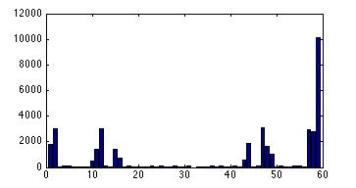

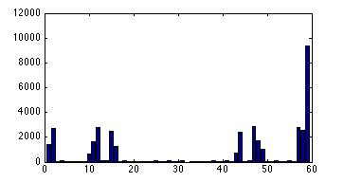

Slide 45
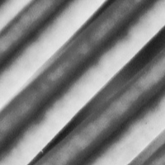
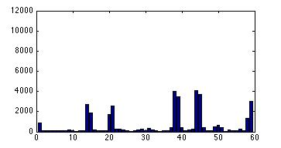

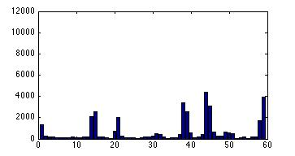

Slide 47
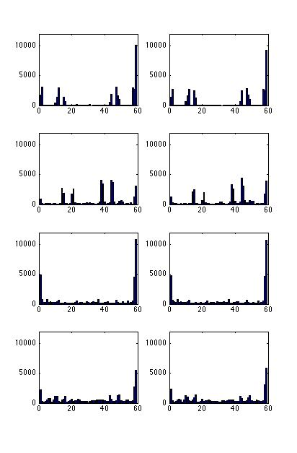
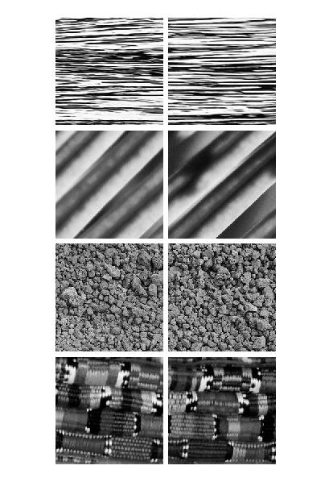

Slide 48
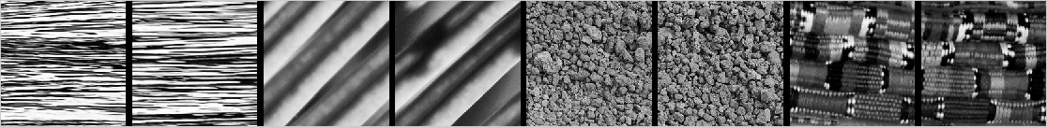

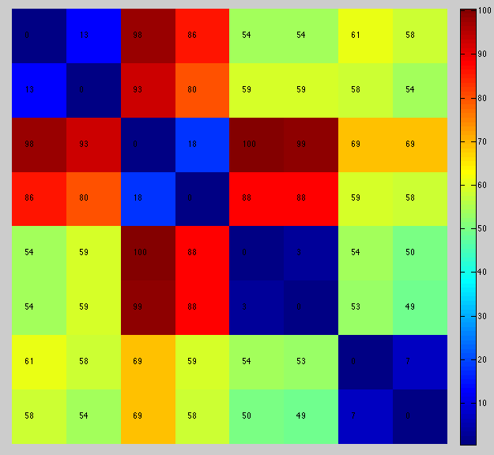

Slide 49
Local Binary Patterns
Examples
Face Recognition

Slide 50
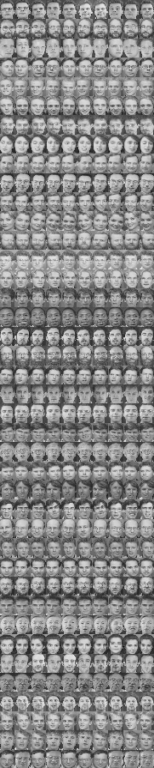


In the training set there are k classes.
For each class we have n training images.
In this example there are 40 classes with 9 images each.
Each image we use w x w partitions
In each partition we extract LBP feature
1
2
3
4
. . .
5 6 7 8
1
2
16
9 10 11 12
16
A face is described using a feature of 16 x 59 = 944 elements
13 14 15

Slide 51
Subject 1
TRAINING
. . .
Training Data:
Table with:
9x40 = 360 rows
16 x 59 = 944 columns
. . .
1
: : :
:
. . .
Subject 20
. . .
. . .
20
: : :
:
. . .
Subject 40
. . .
. . .
: : :
. . .
40

Slide 52
Subject 1
. . .
. . .
: : :
:
. . .
Subject 20
. . .
. . .
: : :
:
. . .
Subject 40
. . .
. . .
: : :
. . .

Slide 53

Subject 1
TESTING
. . .
. . .
1
2
3
4
: : :
:
5 6 7 8
Who is this subject?
. . .
9 10 11 12
13 14 15
16
Subject 20
. . .
. . .
. . .
1
2
16
: : :
:
. . .
Subject 40
. . .
. . .
: : :
. . .

Slide 54
Subject 1
TESTING
. . .
. . .
1
2
3
4
: : :
:
5 6 7 8
Who is this subject?
. . .
9 10 11 12
13 14 15
16
Subject 20
. . .
. . .
. . .
: : :
:
. . .
Subject 40
. . .
. . .
: : :
. . .

Slide 55
Subject 1
Δ
920
781
699
73
65
99
82
128
91
TESTING
. . .
. . .
. . .
1
2
3
4
: : :
:
5 6 7 8
Who is this subject?
. . .
9 10 11 12
13 14 15
16
Subject 20
. . .
. . .
: : :
:
. . .
Subject 40
. . .
. . .
: : :
. . .

Slide 56
Subject 1
Δ
920
781
699
73
65
99
82
128
91
TESTING
. . .
. . .
1
2
3
4
: : :
:
5 6 7 8
Who is this subject?
. . .
9 10 11 12
13 14 15
16
Subject 20
Subject 20
. . .
. . .
Minimum
: : :
:
. . .
Subject 40
. . .
Strategy 1:
The nearest neighbor
. . .
: : :
. . .

Slide 57
Strategy 2:
k – nearest neighbors
(knn)

Slide 58
Subject 1
Δ
920
781
699
73
65
99
82
128
91
TESTING
. . .
. . .
1
2
3
4
: : :
:
5 6 7 8
Who is this subject?
. . .
9 10 11 12
13 14 15
16
Subject 20
Subject 20
. . .
2nd Minimum > Subject 20
. . .
1st Minimum > Subject 20
: : :
:
. . .
Subject 40
. . .
3rd Minimum > Subject 40
. . .
Strategy 2:
k-nearest neighbor (k=3)
: : :
. . .

Slide 59
Strategy 3:
smallest sample-class distance

Slide 60
Subject 1
TESTING
. . .
. . .
1
2
3
4
: : :
:
5 6 7 8
Who is this subject?
. . .
9 10 11 12
13 14 15
16
Subject 20
Subject 20
. . .
. . .
. . .
: : :
:
. . .
Minimal distance
Subject 40
. . .
. . .
: : :
. . .

Slide 61
Subject 1
Δ
120
23
12
TESTING
. . .
. . .
1
2
3
4
: : :
:
5 6 7 8
Who is this subject?
. . .
9 10 11 12
13 14 15
16
Subject 20
Subject 20
. . .
. . .
. . .
: : :
:
. . .
Minimal distance
Subject 40
. . .
. . .
: : :
. . .

Slide 62
Subject 1
Δ
120
+
140
23
+
12
12
+
98
TESTING
. . .
. . .
1
2
3
4
: : :
:
5 6 7 8
Who is this subject?
. . .
9 10 11 12
13 14 15
16
Subject 20
Subject 20
. . .
. . .
. . .
: : :
:
. . .
Minimal distance
Subject 40
. . .
. . .
: : :
. . .

Slide 63
Subject 1
Δ
120
+
140
:
120
23
+
12
+
19
12
+
98
+
123
TESTING
. . .
. . .
1
2
3
4
: : :
:
5 6 7 8
Who is this subject?
. . .
9 10 11 12
13 14 15
16
Subject 20
Subject 20
. . .
. . .
. . .
: : :
:
. . .
Minimal distance
Subject 40
. . .
. . .
: : :
. . .

Slide 64
Subject 1
Δ
120
+
140
:
120
23
+
12
+
19
12
+
98
+
123
TESTING
. . .
. . .
1
2
3
4
: : :
:
5 6 7 8
Who is this subject?
. . .
9 10 11 12
13 14 15
16
Subject 20
Subject 20
Subject 20
. . .
. . .
. . .
: : :
:
. . .
= 54
Minimal total distance
Subject 40
. . .
. . .
: : :
. . .

